Slide 1

EMS Response in NYC: Data Manipulation & Analysis
Diya Mohan & Sumana Chilakamarri

Slide 2
Purpose & Interest
Goals
Hypotheses
Disparity in healthcare accessibility in marginalized communities versus communities of privilege
EMS Dispatch & Response Times in New York City boroughs
NYC has a large-scale model that displays extreme wealth disparities, densely concentrated populations, etc., that serve as a common indicator of wealthy and poorer areas.
Clean, analyze & visualize data to gain insights on different factors regarding EMS Response Time
Compare NYC boroughs based on Dispatch and Response Time
Predict future demographic data using predictive analytics - use this to compare future EMS Response/Dispatch times
We hypothesize that we will find statistically significant indicators that low-income boroughs do in fact receive significantly less emergency medical response resources than high-income boroughs on the basis of EMS efficiency.

Slide 3

Phase I: Dataset Collection

Slide 4
Data Collection Process
Web Scraping
Looked up demographics for NYC boroughs and found relevant data at:
furmancenter.org
Collecting Data
We looked up emergency response rate records for NYC for datasets, found relevant data in government websites
.csv Data
.json Data
.csv was found at: https://data.cityofnewyork.us/, large file with ~25M rows containing dispatch and response time, corresponding borough, etc.
Found data from data.gov, contained data with all types of emergency response times & number of incidents

Slide 5
Phase II: Data Manipulation & Cleaning

Slide 6
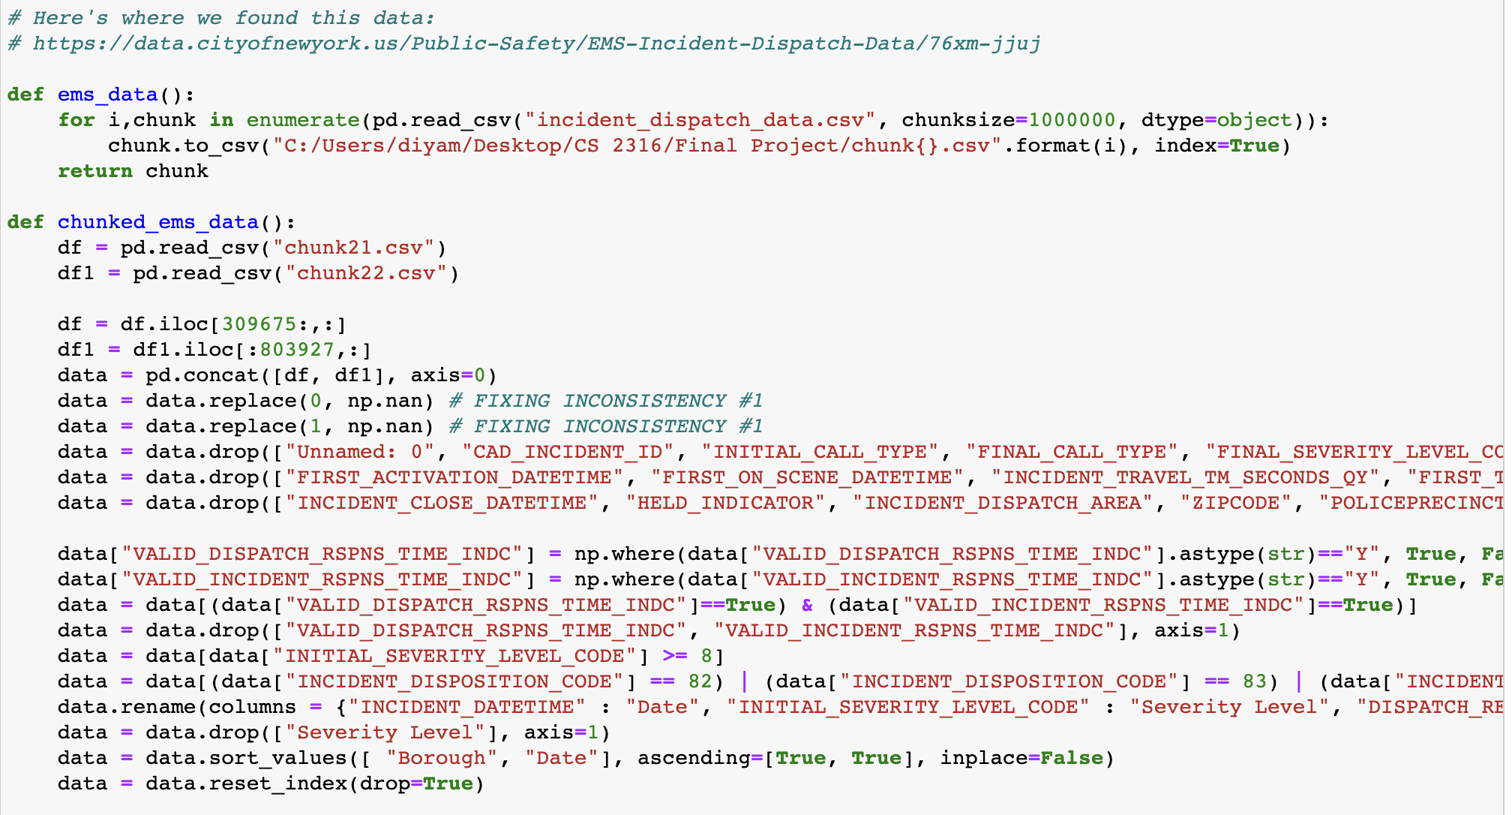
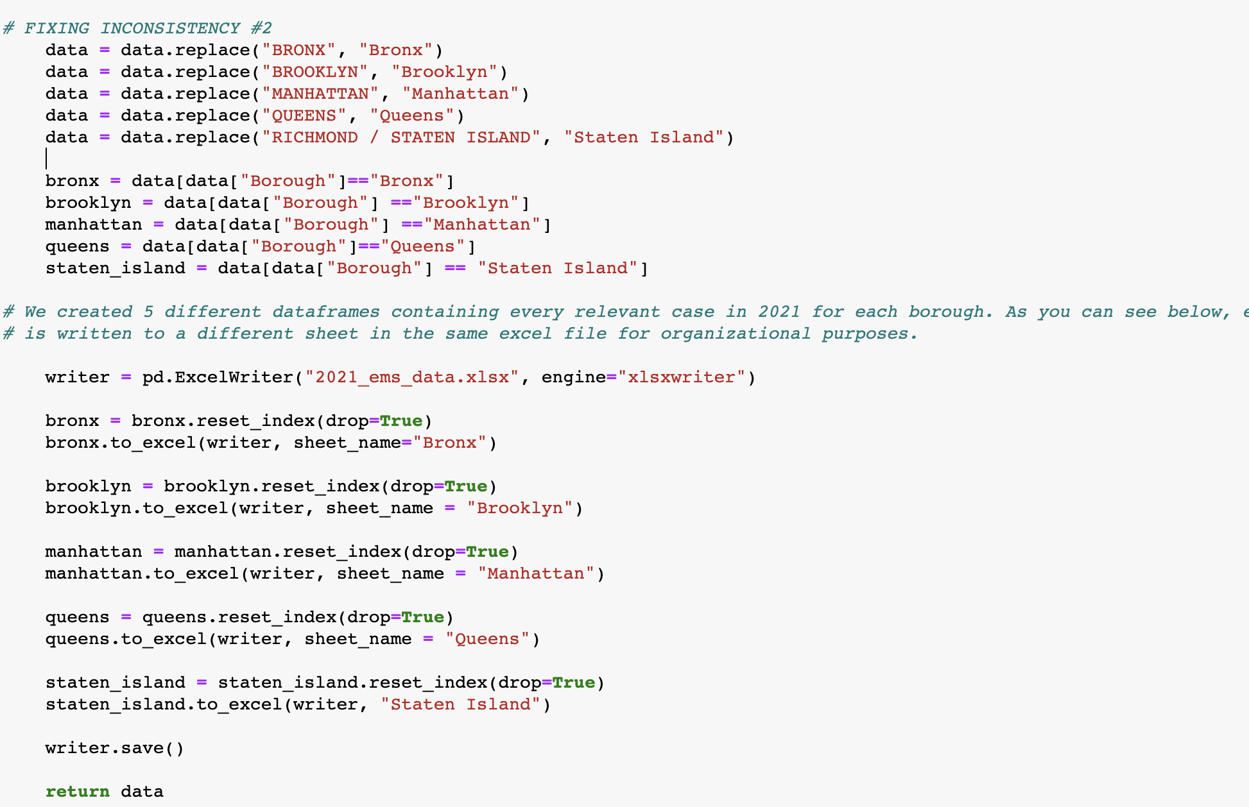
Cleaning our Big Dataset (CSV)
Since our data was ~25M rows, we split it into multiple chunks and only used the chunks with relevant data (from 2021).
We dropped columns that were not relevant to the insights we wanted to find to support our hypothesis
We renamed columns for readability, sorted it, and wrote it to files to cross reference it.

Slide 7
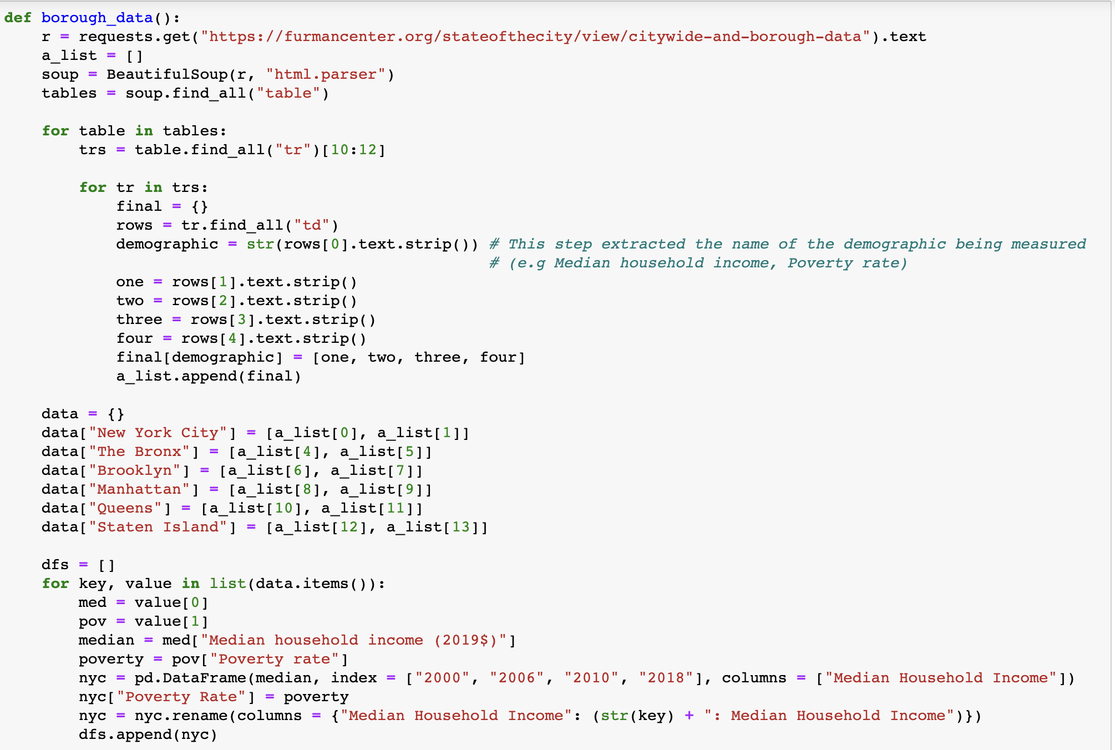
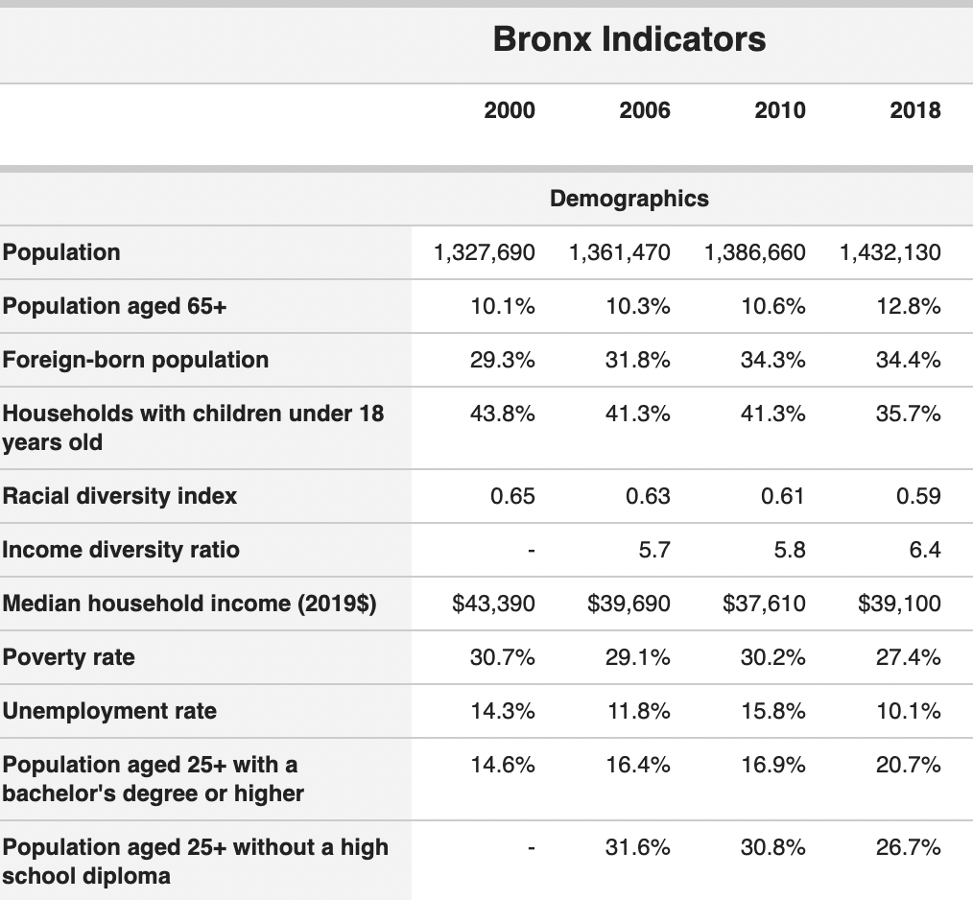
Web Scraping
Used BeautifulSoup to parse through data
Only appended relevant values to our list; added labelled values to DataFrame for easier comparison & visualization
We wanted to extract only median household income & poverty rates across several years for each borough, and the website we used had many demographics we had to parse through.

Slide 8
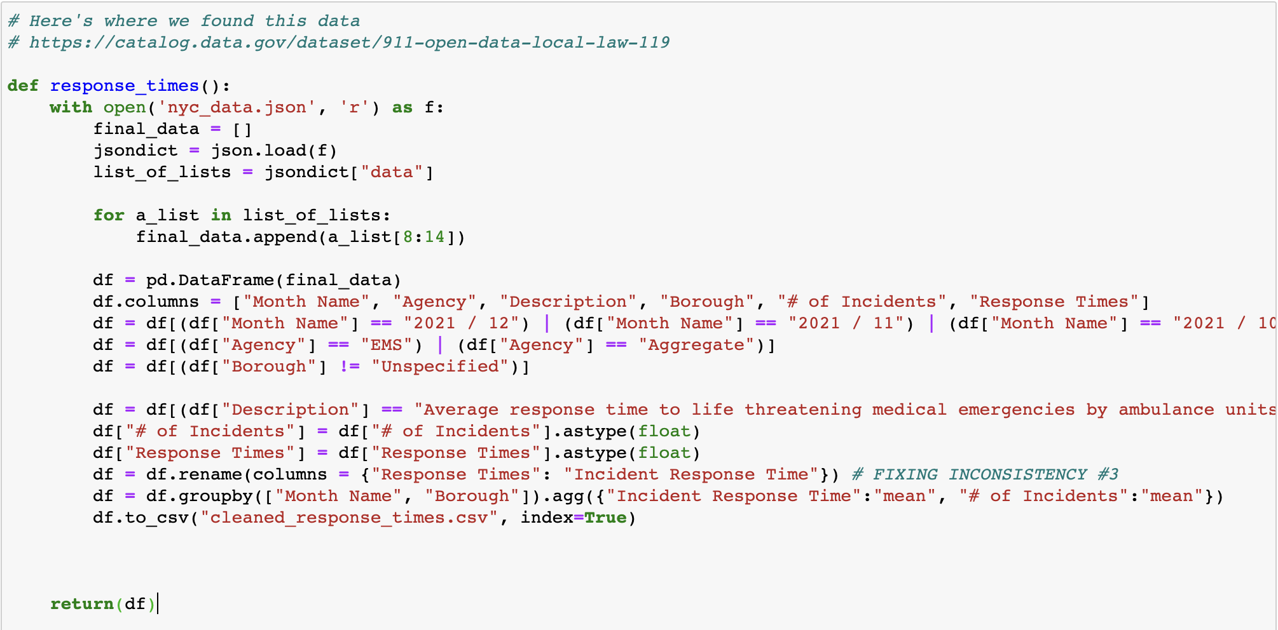
We used json.load() to convert to a dictionary, converted dictionary to Pandas DataFrame and only included # of Incidents and Response Times
We appended relevant values from the .json to a Pandas Dataframe and only kept columns in the year matching to that of the big .csv for comparison purposes.
JSON data
We used masking to only include severe, life threatening accidents for better data visualization

Slide 9
Phase III: Data Analysis

Slide 10
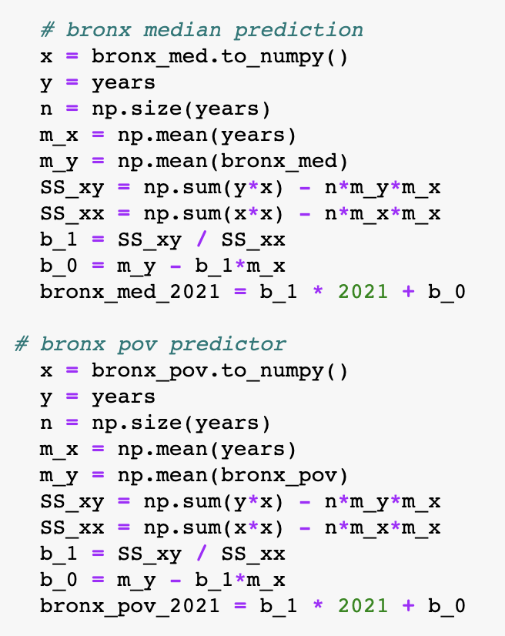
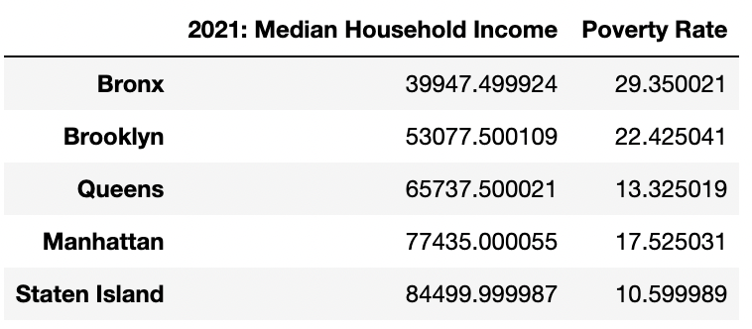
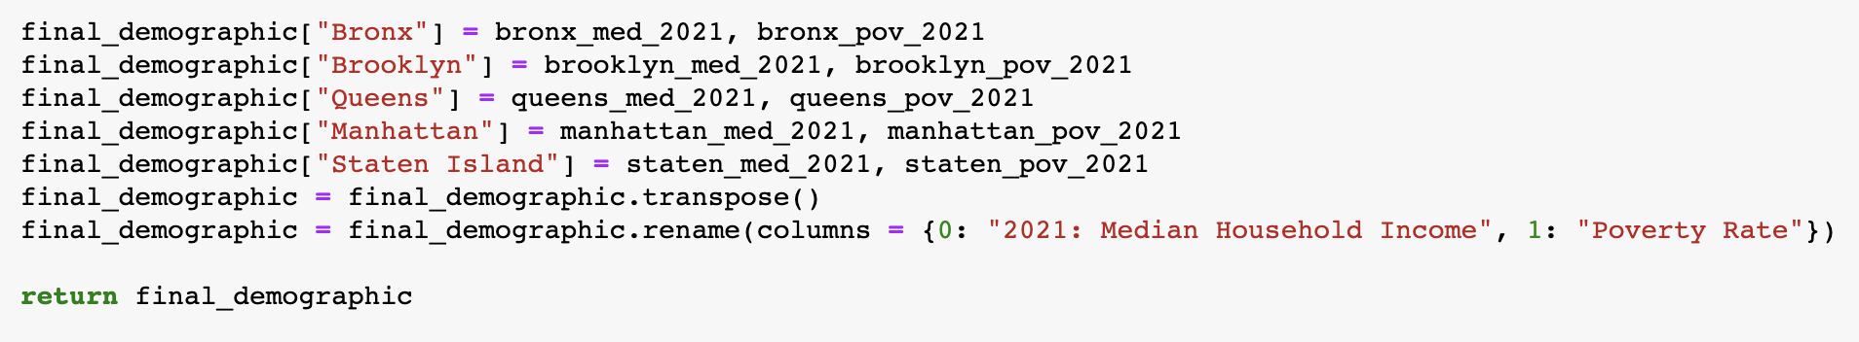
Insight 1
This data helped us to rank the boroughs and recognize which ones fall under low-income and high-income in 2021.
Boroughs such as the Bronx and Brooklyn had the lowest median household incomes and highest poverty rates while boroughs such as Manhattan and Staten Island had the highest median incomes and lowest poverty rates in 2021.

Slide 11
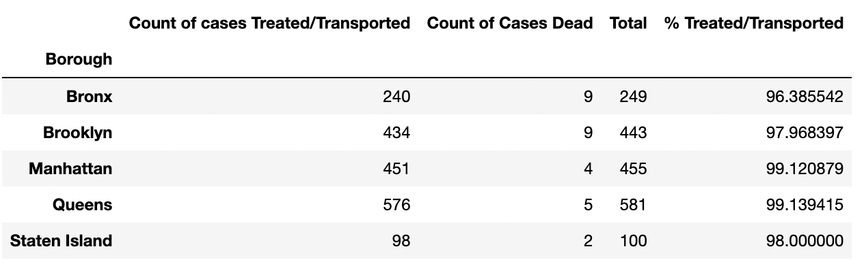
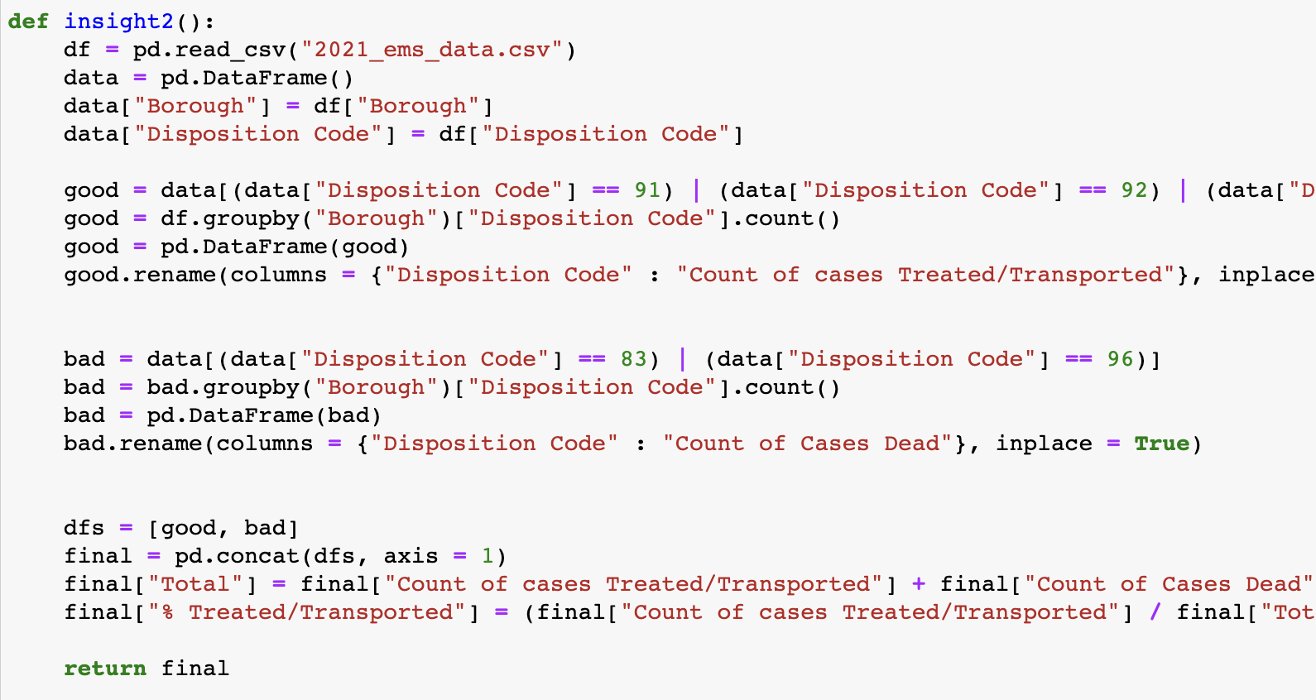
Insight 2
The lowest percent of EMS incidents treated and transported fall under lower-income boroughs such as Brooklyn and Bronx.
We used masking to group by disposition code to see the patient outcomes per borough.

Slide 12
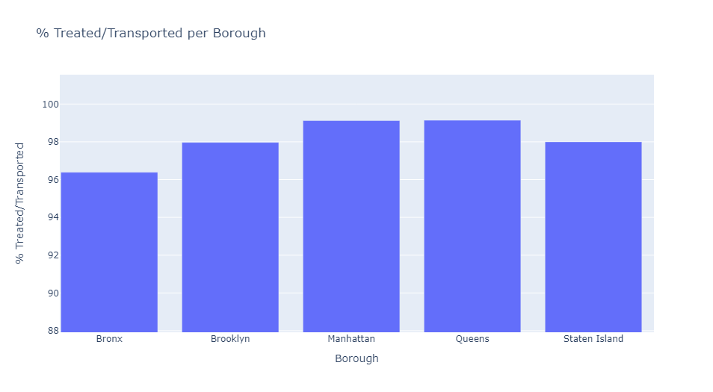
Data Visualization #1
This bar graph supports our second insight: the % treated for lower income boroughs is lower than that of higher income boroughs

Slide 13
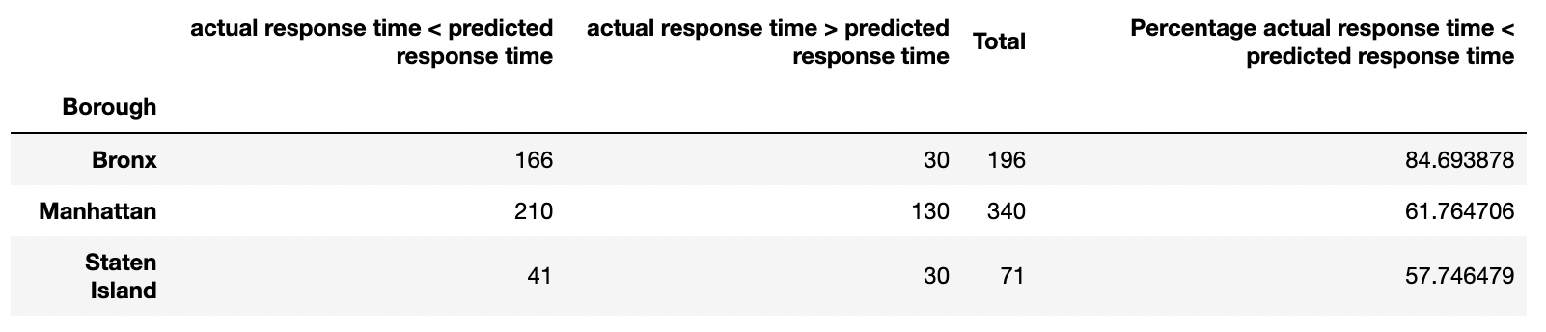
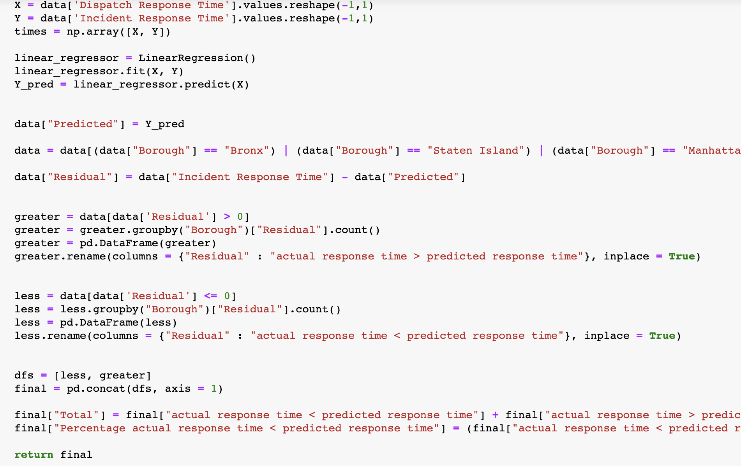
Insight #3
MERCURY
MARS
VENUS
SATURN
Mercury is the closest planet to the Sun and the smallest one in the Solar System
Lower income boroughs (Bronx) had the greatest percentage of their cases where actual response time was less than predicted as opposed to higher income boroughs such as Manhattan and Staten Island.
We ran an ordinary linear regression between the two variables and found residuals for incident response times:
defined as the actual incident response time minus the predicted incident response time based on our linear regression
for each borough, we counted the positive residuals and the negative residuals

Slide 14
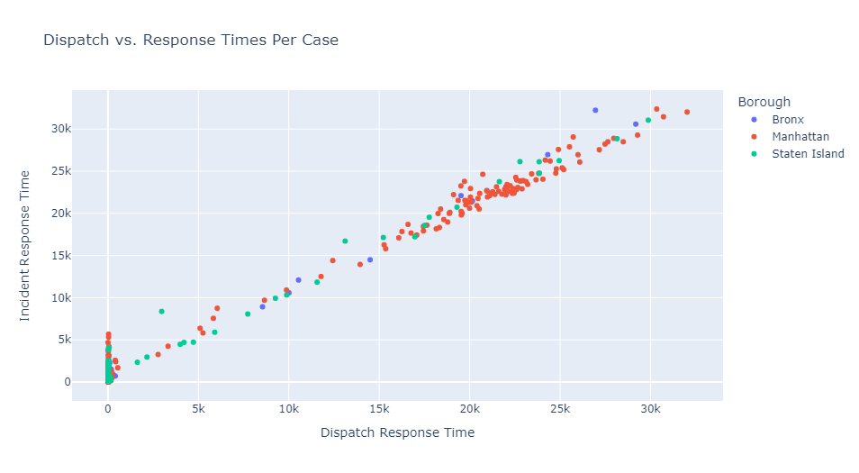
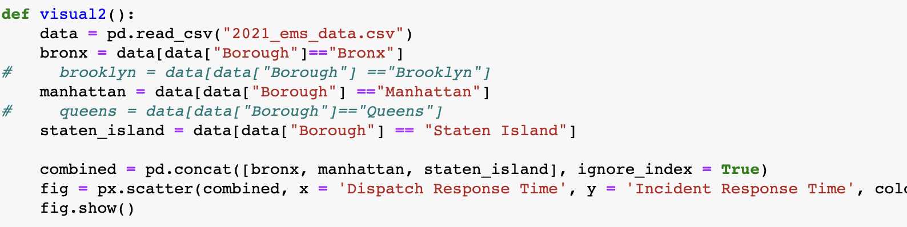
Data Visualization #2
This visual supports the regression made in insight 3: it displays the strong, positive correlation in Dispatch response time vs Incident response time
Shows the different boroughs and where their data points lie, clusters in data, etc.

Slide 15
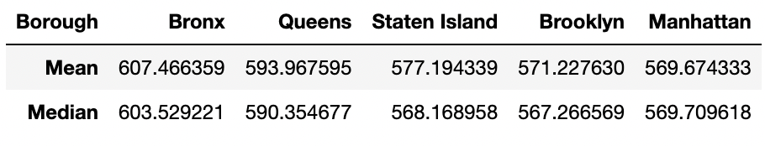
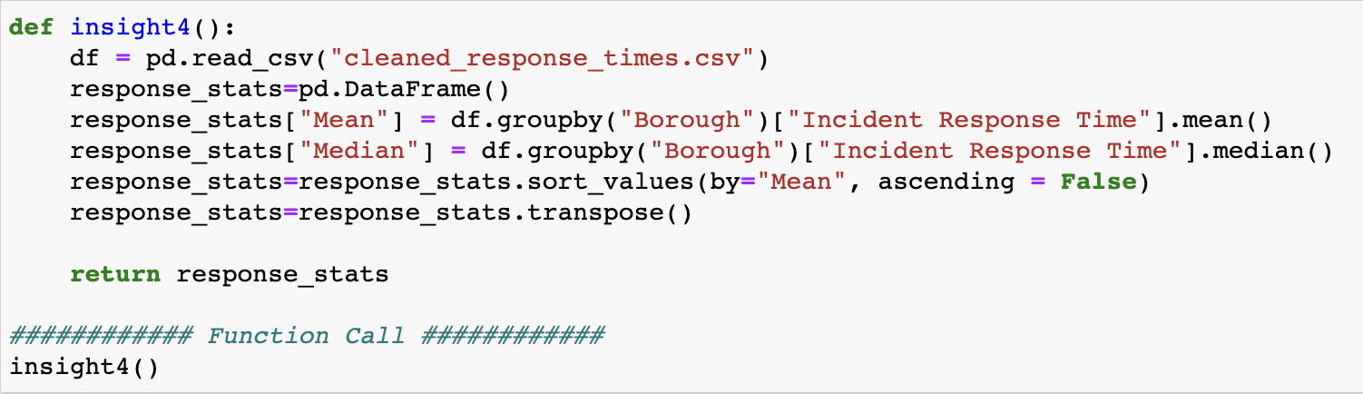
Insight 4
We used aggregate methods to find the average and median, both measures of center, of the incident response time in each borough and sorted them from highest response time to lowest response time.
Lower income boroughs have a higher mean and median incident response time as compared to higher income boroughs.

Slide 16
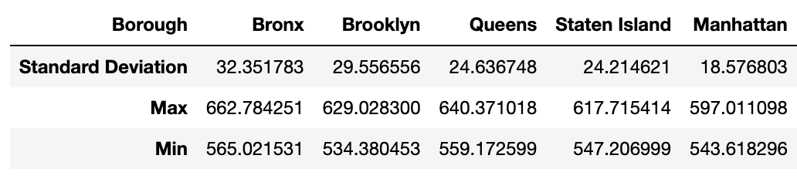
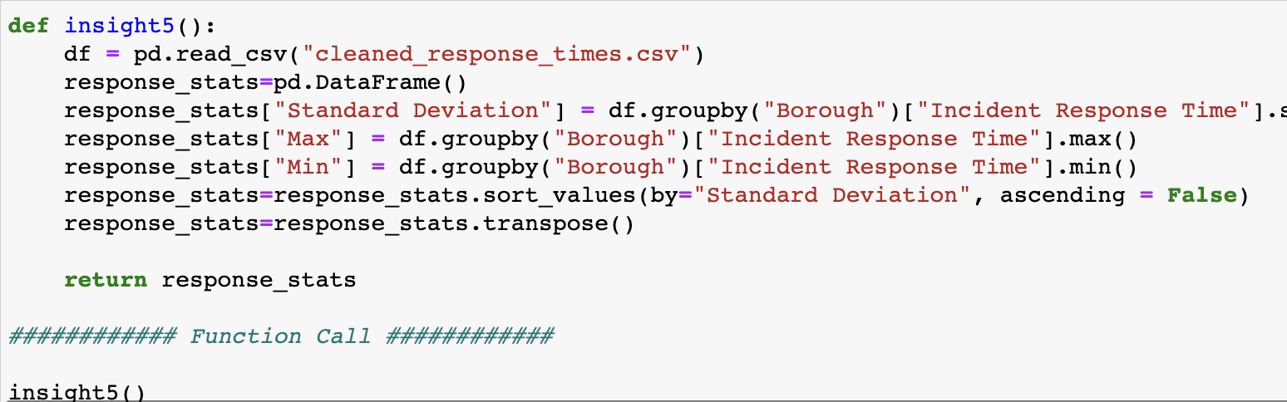
Insight 5
Lower income boroughs, including the Bronx and Brooklyn, have a greater spread of incident response times than higher income boroughs, including Manhattan.
The spread of data varies significantly from borough to borough:
Standard Deviation in the Bronx is much higher than that of Manhattan
There is more spread in the Bronx data, meaning that values are extremely high and extremely low

Slide 17
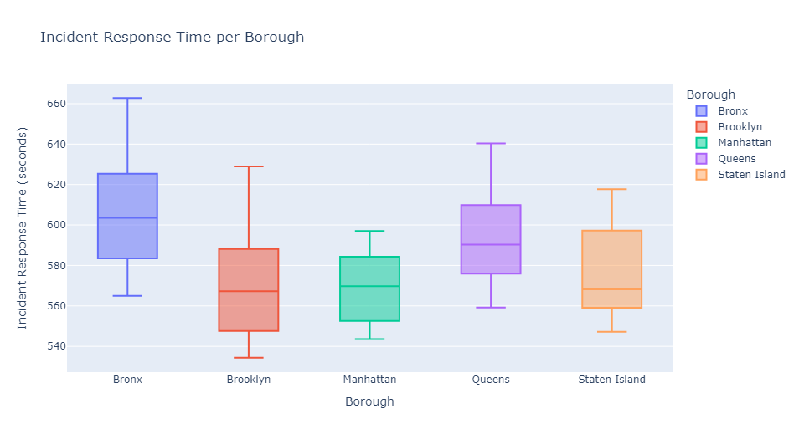
Data Visualization 3
This visualization substantiates insight 4 and insight 5: The measures of center and spread are shown through the median and overall range of the data for each borough.

Slide 18

Overall Results
Conclusions & Takeaways
Challenges
There are indicators in our cleaned data that show that there is a difference between EMS response times in high-income boroughs versus low-income boroughs.
Manipulating data into similar Data Frames using Pandas, numpy, etc., cleans data so that it can be cross referenced and compared with other datasets.
Parsing through our dataset with ~25M rows as Excel didn’t show all the rows of data
We had to break the dataset up into chunks of data and only include the data relevant to our hypothesis
Code regarding regression for predictive analytics within the HTML dataset
Using different forms of linear regression in our code

